Slide 1
Classification &Prediction
Vijayalakshmi Anand

Slide 2
Classification and Prediction
What is Classification
Classification vs Prediction
Decision trees for classification
Examples of Decision trees
Attribute splitting techniques
Challenges of classification

Slide 3
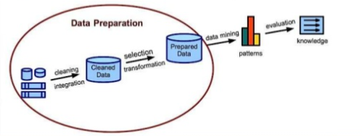
Data mining process

Slide 4


What is classification?
Classification is the task of assigning objects to one of the predefined categories
Following are some of the examples of classification tasks
Predicting tumor cells as benign or malignant
Classifying credit card transactions as legitimate or fraudulent

Slide 5

Categorizing news stories as finance, weather, entertainment, sports, etc

Slide 6

Contd..
Detecting spam email messages based upon the message header and contents

Slide 7
Classification: Definition
Given a collection of records (training set )
Each record contains a set of attributes, one of the attributes is the class.
Find a model for class attribute as a function of the values of other attributes.
Goal: previously unseen records should be assigned a class as accurately as possible.
A test set is used to determine the accuracy of the model.
Notes:
Usually, the given data set is divided into training and test sets, with training set used to build the model and test set used to validate it.

Slide 8
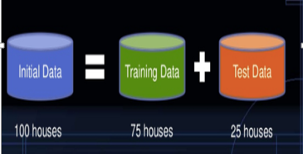
What is Training data and Test data

Slide 9


Classification vs Prediction
Classification
Prediction
Predicts categorical class labels
Use labels of the training data to classify new data
Example
A model or classifier is constructed
to predict categorical labels such as
“safe” or “risky” for a loan
application data.
Models continuous-valued functions, i.e.,
predicts unknown or missing values
Example
A marketing manager would like to predict how much a given costumer will spend during a sale
Unlike classification, it provides ordered Values
Regression analysis is used for
Prediction
Prediction is a short name for numeric
prediction

Slide 10
Supervised vs. Unsupervised Learning
Supervised learning (classification)
Supervision: The training data (observations, measurements, etc.) are accompanied by labels indicating the class of the observations
New data is classified based on the training set
Unsupervised learning (clustering)
The class labels of training data is unknown
Given a set of measurements, observations, etc. with the aim of establishing the existence of classes or clusters in the data

Slide 11
Classification—A Two-Step Process
Model construction: describing a set of predetermined classes
Each tuple/sample is assumed to belong to a predefined class, as determined by the class label attribute
The set of tuples and their associated class labels, used for model construction is training set
The model is represented as classification rules, decision trees, or mathematical formulae

Slide 12
Model usage:
for classifying future or unknown objects
Estimate accuracy of the model
The known label of test sample is compared with the classified result from the model
Accuracy rate is the percentage of test set samples that are correctly classified by the model
Test set is independent of training set (otherwise overfitting)
If the accuracy is acceptable, use the model to classify new data
Note: If the test set is used to select models, it is called validation (test) set

Slide 13
Process (1): Model Construction
Classification
Algorithms
Training
Data
Classifier
(Model)
IF rank = ‘professor’
OR years > 6
THEN tenured = ‘yes’

Slide 14
Process (2): Using the Model in Prediction
Classifier
Testing
Data
Unseen Data
(Jeff, Professor, 4)
Tenured?

Slide 15
Lazy vs. Eager Learning
Lazy vs. eager learning
Lazy learning (e.g., instance-based learning): Simply stores training data (or only minor processing) and waits until it is given a test tuple
Eager learning (the above discussed methods): Given a set of training set, constructs a classification model before receiving new (e.g., test) data to classify
Lazy: less time in training but more time in predicting

Slide 16
Lazy Learner: Instance-Based Methods
Instance-based learning:
Store training examples and delay the processing (“lazy evaluation”) until a new instance must be classified
Typical approaches
K-Nearest neighbors
Case based reasoning

Slide 17
Evaluating Classification Methods
Accuracy
classifier accuracy: predicting class label
predictor accuracy: guessing value of predicted attributes
Speed
time to construct the model (training time)
time to use the model (classification/prediction time)
Robustness: handling noise and missing values
Scalability: efficiency in disk-resident databases
Interpretability
understanding and insight provided by the model

Slide 18
Classification Techniques
Decision Tree based Methods
Rule-based Methods
Neural Networks
computational networks that simulate the decision process in neurons (networks of nerve cell)
Naïve Bayes and Bayesian Belief Networks
uses the probability theory to find the most likely of the possible classifications
Support Vector Machines
fits a boundary to a region of points that are all alike; uses the boundary to classify a new point

Slide 19
Decision tree classification Method

Slide 20
Decision tree
Decision tree is a flowchart-like tree structure,
internal node (denoted by rectangles) denotes a test on an attribute,
each branch represents an outcome of the test, and
each leaf node (or terminal node, denoted by ovals ) holds a class label. It represents the concept buys computer, that is, it predicts whether a customer at
Used for classification.
Easily converted to classification rules.
Does not require any domain knowledge.
Decision tree algorithms: ID3(Iterative Dichotomiser), C4.5 (successor of ID3), CART(classification and regression trees).

Slide 21
Example of a Decision Tree
categorical
categorical
continuous
Splitting Attributes
class
Refund
Yes
No
NO
MarSt
Single, Divorced
Married
TaxInc
NO
< 80K
> 80K
NO
YES
Training Data
Model: Decision Tree

Slide 22
Another Example of Decision Tree
categorical
categorical
continuous
class
MarSt
Single, Divorced
Married
NO
Refund
Yes
No
NO
TaxInc
< 80K
> 80K
NO
YES
There could be more than one tree that fits the same data!

Slide 23
Apply Model to Test Data
Start from the root of tree.
Test Data
Refund
Yes
No
NO
MarSt
Single, Divorced
Married
TaxInc
NO
< 80K
> 80K
NO
YES

Slide 24
Apply Model to Test Data
Test Data
Refund
Yes
No
NO
MarSt
Single, Divorced
Married
TaxInc
NO
< 80K
> 80K
NO
YES

Slide 25
Apply Model to Test Data
Test Data
Refund
Yes
No
NO
MarSt
Single, Divorced
Married
TaxInc
NO
< 80K
> 80K
NO
YES

Slide 26
Apply Model to Test Data
Test Data
Refund
Yes
No
NO
MarSt
Single, Divorced
Married
TaxInc
NO
< 80K
> 80K
NO
YES

Slide 27
Apply Model to Test Data
Test Data
Refund
Yes
No
NO
MarSt
Single, Divorced
Married
TaxInc
NO
< 80K
> 80K
NO
YES

Slide 28
Apply Model to Test Data
Test Data
Refund
Yes
No
NO
MarSt
Single, Divorced
Married
Assign Cheat to “No”
TaxInc
NO
< 80K
> 80K
NO
YES

Slide 29
Tree Induction
Greedy strategy.
Split the records based on an attribute test that optimizes certain criterion.
Issues
Determine how to split the records
How to specify the attribute test condition?
How to determine the best split?
Determine when to stop splitting

Slide 30
How to Specify Test Condition?
Depends on attribute types
Nominal
Ordinal
Continuous
Depends on number of ways to split
2-way split
Multi-way split

Slide 31
Method for expressing attribute test condition for all type of attributes

Slide 32
Splitting Based on Nominal Attributes
Multi-way split: Use as many partitions as distinct values.
Binary split: Divides values into two subsets. Need to find optimal partitioning.
CarType
Family
Luxury
Sports
OR
CarType
CarType
{Sports, Luxury}
{Family, Luxury}
{Family}
{Sports}

Slide 33
Splitting Based on Ordinal Attributes
Multi-way split: Use as many partitions as distinct values.
Binary split: Divides values into two subsets. Need to find optimal partitioning.
Size
Small
Large
Medium
Size
OR
Size
{Small, Medium}
{Medium, Large}
{Large}
{Small}
Size
{Small, Large}
{Medium}

Slide 34
Splitting Based on Continuous Attributes
Different ways of handling
Discretization to form an ordinal categorical attribute
Static – discretize once at the beginning
Dynamic – ranges can be found by equal interval bucketing, equal frequency bucketing (percentiles), or clustering.
Binary Decision: (A < v) or (A ≥ v)
consider all possible splits and finds the best cut
can be more compute intensive

Slide 35
Splitting Based on Continuous Attributes

Slide 36
How to determine the Best Split
Before Splitting: 10 records of class 0, 10 records of class 1
Which test condition is the best?
36

Slide 37
How to determine the Best Split
Greedy approach:
Nodes with homogeneous class distribution are preferred
Need a measure of node impurity:
Non-homogeneous,
High degree of impurity
Homogeneous,
Low degree of impurity

Slide 38
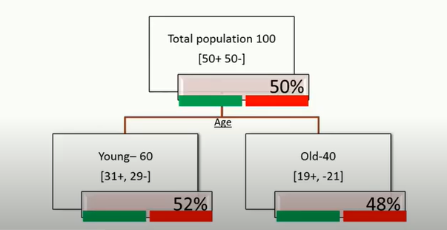
Example

Slide 39
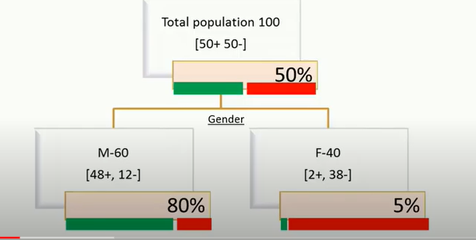
Contd..

Slide 40
Measure of Node Impurity

Slide 41
Measures of Node Impurity
Gini Index
Entropy (Information Gain)
Misclassification error

Slide 42
Gini index

Slide 43
Measure of Impurity: GINI
Gini Index for a given node t :
(NOTE: p( j | t) is the relative frequency of class j at node t).
Maximum =when records are equally distributed among all classes, implying least interesting information
Minimum -when all records belong to one class, implying most interesting information

Slide 44
Examples for computing GINI
P(C1) = 0/6 = 0 P(C2) = 6/6 = 1
Gini = 1 – P(C1)² – P(C2)² = 1 – 0 – 1 = 0
P(C1) = 1/6 P(C2) = 5/6
Gini = 1 – (1/6)² – (5/6)² = 0.278
P(C1) = 2/6 P(C2) = 4/6
Gini = 1 – (2/6)² – (4/6)² = 0.444

Slide 45
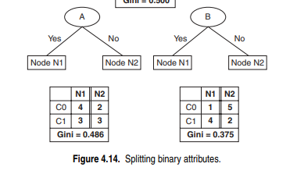
Binary Attributes: Computing GINI Index
Splits into two partitions
Effect of Weighing partitions:
Larger and Purer Partitions are sought for.
B?
Yes
No
Gini(N1) = 1 – (5/7)² – (2/7)² = 0.278
Gini(N2) = 1 – (1/5)² – (4/5)² = 0.32
Node N1
Node N2
Gini(Children) = 7/12 * 0.278 + 5/12 * 0.32 = 0.295

Slide 46
Categorical Attributes: Computing Gini Index
For each distinct value, gather counts for each class in the dataset
Use the count matrix to make decisions
Multi-way split
Two-way split
(find best partition of values)

Slide 47
Continuous Attributes: Computing Gini Index
Use Binary Decisions based on one value
Several Choices for the splitting value
Number of possible splitting values = Number of distinct values
Each splitting value has a count matrix associated with it
Class counts in each of the partitions, A < v and A ≥ v
Simple method to choose best v
For each v, scan the database to gather count matrix and compute its Gini index
Computationally Inefficient! Repetition of work.

Slide 48
Continuous Attributes: Computing Gini Index...
For efficient computation: for each attribute,
Sort the attribute on values
Linearly scan these values, each time updating the count matrix and computing gini index
Choose the split position that has the least gini index
Sorted Values
Split Positions

Slide 49
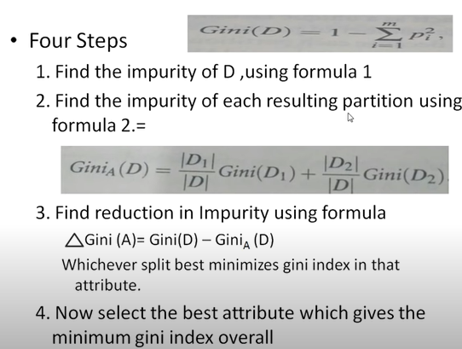

Slide 50
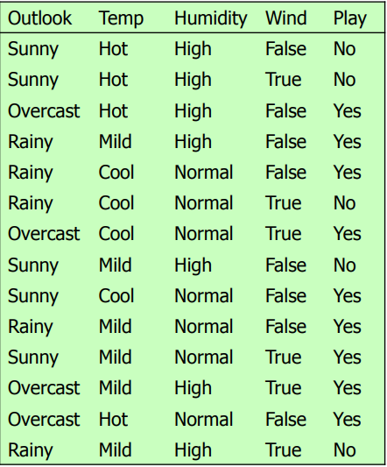
Example1

Slide 51
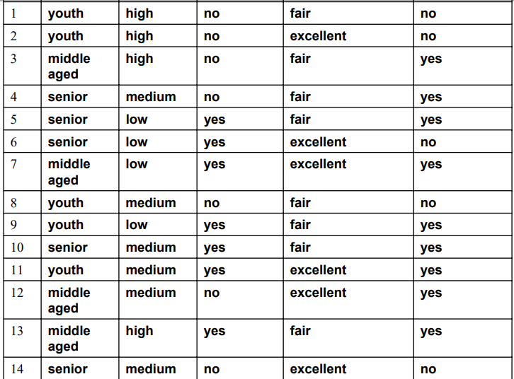
Example-Computer buy prediction
Slno | Age | Income | Creditraing | students | Buy computer

Slide 52

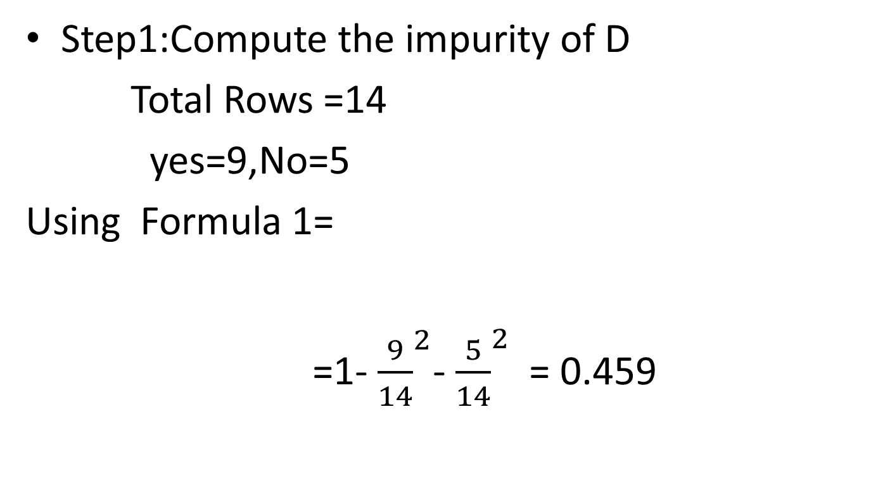
Step1:Compute the impurity of D
Total Rows =14
yes=9,No=5
Using Formula 1=
=1-${ \frac{9}{14}}^{2}$-${ \frac{5}{14}}^{2}$ = 0.459

Slide 53
Step2-splitting each attribute
Credit rating –binary value

Slide 54
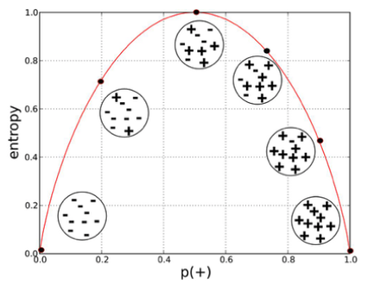
Alternative Splitting Criteria
Entropy at a given node t:
(NOTE: p( j | t) is the relative frequency of class j at node t).
Measures homogeneity of a node.
Maximum (log nc) when records are equally distributed among all classes implying least information
Minimum (0.0) when all records belong to one class, implying most information
Entropy based computations are similar to the GINI index computations

Slide 55
Examples for computing Entropy
P(C1) = 0/6 = 0 P(C2) = 6/6 = 1
Entropy = – 0 log 0 – 1 log 1 = – 0 – 0 = 0
P(C1) = 1/6 P(C2) = 5/6
Entropy = – (1/6) log₂ (1/6) – (5/6) log₂ (1/6) = 0.65
P(C1) = 2/6 P(C2) = 4/6
Entropy = – (2/6) log₂ (2/6) – (4/6) log₂ (4/6) = 0.92

Slide 56
Splitting Criteria based on Classification Error
Classification error at a node t :
Measures misclassification error made by a node.
Maximum (1 - 1/nc) when records are equally distributed among all classes, implying least interesting information
Minimum (0.0) when all records belong to one class, implying most interesting information

Slide 57
Examples for Computing Error
P(C1) = 0/6 = 0 P(C2) = 6/6 = 1
Error = 1 – max (0, 1) = 1 – 1 = 0
P(C1) = 1/6 P(C2) = 5/6
Error = 1 – max (1/6, 5/6) = 1 – 5/6 = 1/6
P(C1) = 2/6 P(C2) = 4/6
Error = 1 – max (2/6, 4/6) = 1 – 4/6 = 1/3

Slide 58
Stopping Criteria for Tree Induction
Stop expanding a node when all the records belong to the same class
Stop expanding a node when all the records have similar attribute values
Early termination

Slide 59
Decision Tree Based Classification
Advantages:
Inexpensive to construct
Extremely fast at classifying unknown records
Easy to interpret for small-sized trees
Accuracy is comparable to other classification techniques for many simple data sets

Slide 60
Practical Issues of Classification
Underfitting and Overfitting
Missing Values
Costs of Classification

Slide 61
Underfitting vs. Overfitting
Underfitting results in decision trees that are too simple to solve the problem. They may offer superior interpretability.
Overfitting results in decision trees that are more complex than necessary
Training error no longer provides a good estimate of how well the tree will perform on previously unseen records
Need new ways for estimating errors

Slide 62
How to Address Overfitting
Pre-Pruning (Early Stopping Rule)
Stop the algorithm before it becomes a fully-grown tree
General stopping conditions for a node:
Stop if all instances belong to the same class
Stop if all the attribute values are the same
More restrictive conditions (for pre-pruning) :
Stop if number of instances is less than some user-specified threshold
Stop if class distribution of instances are independent of the available features (e.g., using χ 2 test)
Stop if expanding the current node does not improve impurity measures (e.g., Gini or information gain).

Slide 63
How to Address Overfitting…
Post-pruning
Grow decision tree to its entirety
Trim the nodes of the decision tree in a bottom-up fashion
If generalization error(i.e. expected error of the model on previously unseen records) improves after trimming, replace sub-tree by a leaf node.
Class label of leaf node is determined from majority class of instances in the sub-tree

Slide 64
Handling Missing Attribute Values
Missing values affect decision tree construction in three different ways:
Affects how impurity measures are computed
Affects how to distribute instance with missing value to child nodes
Affects how a test instance with missing value is classified

Slide 65
Decision Boundary
Border line between two neighboring regions of different classes is known as decision boundary
Decision boundary is parallel to axes because test condition involves a single attribute at-a-time

Slide 66
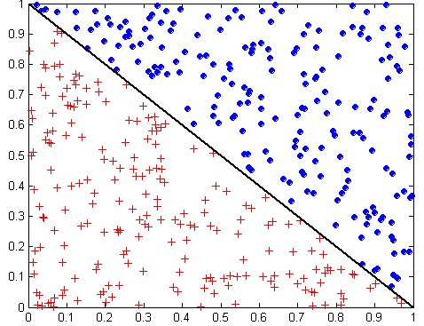
Oblique Decision Trees
x + y < 1
Class = +
Class =
Test condition may involve multiple attributes
More expressive representation
Finding optimal test condition is computationally expensive

Slide 67
Other Issues
Data Fragmentation
Search Strategy
Expressiveness
Tree Replication
Same subtree appears in multiple branches

Slide 68
Data Fragmentation
Number of instances gets smaller as you traverse down the tree
Number of instances at the leaf nodes could be too small to make any statistically significant decision

Slide 69
Search Strategy
Finding an optimal decision tree is NP-complete problem. Many algorithms employ heuristic-based approach.
The algorithm presented uses a greedy, top-down, recursive partitioning strategy to induce a reasonable solution
Other strategies?
Bottom-up
Bi-directional

Slide 70
Expressiveness
Decision tree provides expressive representation for learning discrete-valued function
But they do not generalize well to certain types of Boolean functions
Example: parity function:
Class = 1 if there is an even number of Boolean attributes with truth value = True
Class = 0 if there is an odd number of Boolean attributes with truth value = True
For accurate modeling, must have a complete tree
Not expressive enough for modeling continuous variables
Particularly when test condition involves only a single attribute at-a-time

Slide 71
Decision Tree Induction
Many Algorithms:
Hunt’s Algorithm (one of the earliest)
CART
ID3, C4.5
SLIQ,SPRINT

Slide 72
Thank you ☺
Q&A
Suggestions / Feedback

